Slide 1
Use Case Exercise
(2 hours)

Slide 2
Exercise
Goal: writing use cases
Team arrangement
  Please create an ad hoc team with your friends
    You are encouraged (but not required) to form an ad hoc team with your project teammates
  Each team should have 3-4 students
    Teamwork is required.
  Move your desks to allow easy discussion

Slide 3
Exercise
You are required to
  Understand the target App as much as you can.
  Draw a use case diagram
    Identify MOST use cases by name
  Write the use cases in fully dressed format for the target scenario
  Your use cases should mostly pass the 3 tests, namely boss test, EBP test, and size test.
  In addition to the main success scenario, do not forget to write alternative scenarios in the extension section.
  You have 60-80 minutes to write use cases
  1 team will be selected to show your use cases to your classmates in the class

Slide 4
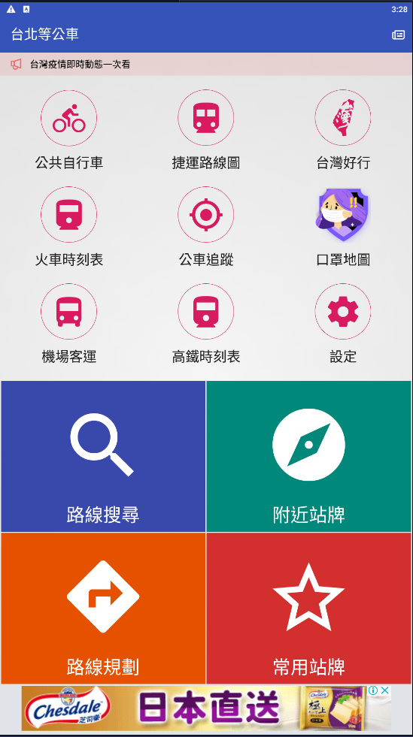
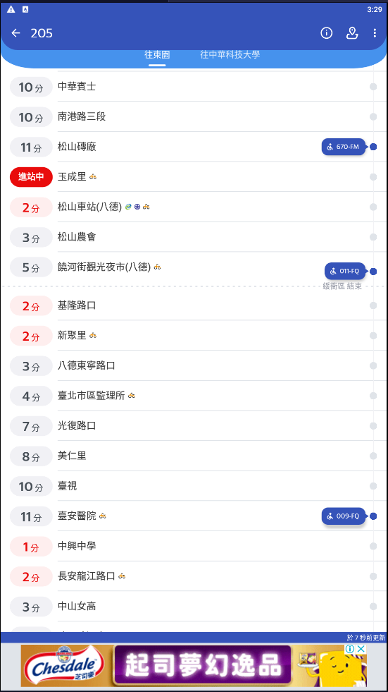
Exercise
Target App: 台北等公車(Google Play or App Store)
  路線規劃 (Plan Route)
    選擇起點、終點，搜尋路線，選擇路線，查看公車路線
  常用站牌(Add Favorite)
    新增常用站牌群組，加入常用站牌，選擇前往路線，查看公車路線
Upload deadline: upload your use cases to Teams before 4/22 23:59

Slide 5
Exercise
Reference terms
FavoriteGroup | 常用站牌群組
User | 使用者
TravelPlan | 旅行規劃
BusTable | 公車表
Route | 路徑
Name | 名稱
Price | 價格
Message | 訊息
WalkRoute | 走路路徑
BusRoute | 公車路徑
Photo | 相片
Stop | 車站
Bus | 公車
Notice | 到站提醒
Favorite | 常用站牌
BusLine | 公車路線
Text | 文字
RouteMap | 路徑圖
Coordinate | 座標
StopAtTime | 到站時間
ArrivalTime | 抵達時間
Category | 總類
Section | 票價區間
Date | 日期
Share | 分享
Keyboard | 鍵盤
Scrollbat | 滾動條
SearchBar | 搜尋條
System | 系統
Controller | 控制器
Icon | 圖示
Menu | 選單
Video | 影像
Advertisement | 廣告
Setting | 設定
Timer | 計時器

Slide 6
Exercise
Important notes
  Make sure that the important concepts (objects) and attributes are captured in your use case so that you do not miss them when drawing domain model in the next step
    Finding objects before assigning responsibilities (devising algorithms)
  A use-case scenario is a series of interactions between the user and the system. In addition to writing what the user does, you should also write what the system does (e.g., what the system shows).

Slide 7
Lessons Learned
Were the use cases perfectly written? Can someone recreate the App by reading your use cases?
How can the use cases be improved?
Given the same requirements, did different teams come up the same use cases?
Did you write any non-functional requirements?
Was a team better than a single person?
Which team created the “best” use cases?

